Slide 1

LET HR TALK Để Mị Nói Cho Mà Nghe

Slide 2
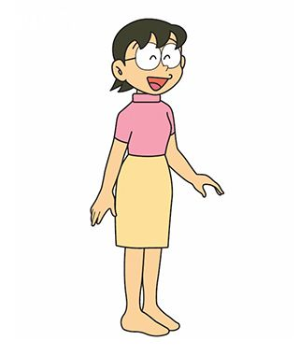
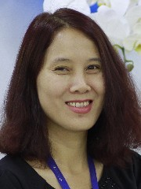



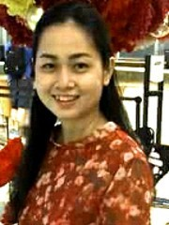


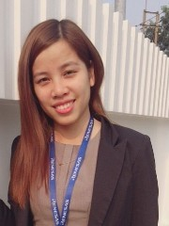


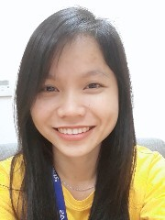

Policies – Covid-19 – Health Insurances – Training, OTP, LTT… – Cadena – Party…
Take care of 8 Xuka & 1 Nobita
Recruitment – Charity –University relation…
Lunch – Cleaning Service– Gardening – Pet Control – Visitor – Purchasing- – Car – Security …

Slide 3
NHI

Slide 4
KIET

Slide 5


H.R.G.A TEAM BIỆT ĐỘI H.R.G.A

Slide 6
ALWAYS LISTEN

Slide 7

WE CARE ABOUT YOU

Slide 8


Slide 9


Slide 10


Slide 11


Slide 12


Slide 13


Slide 14


